Slide 1

Eduto
Learning & Administration System

Slide 2
Problems Addressed
Administration in schools done on paper
Inefficient and inconvenient
No unified platform

Slide 3
Features
Auto attendance taking
Task / Homework management
Context-based learning info

Slide 4


Live Demo
Phone app for students
Web portal for teachers

Slide 5
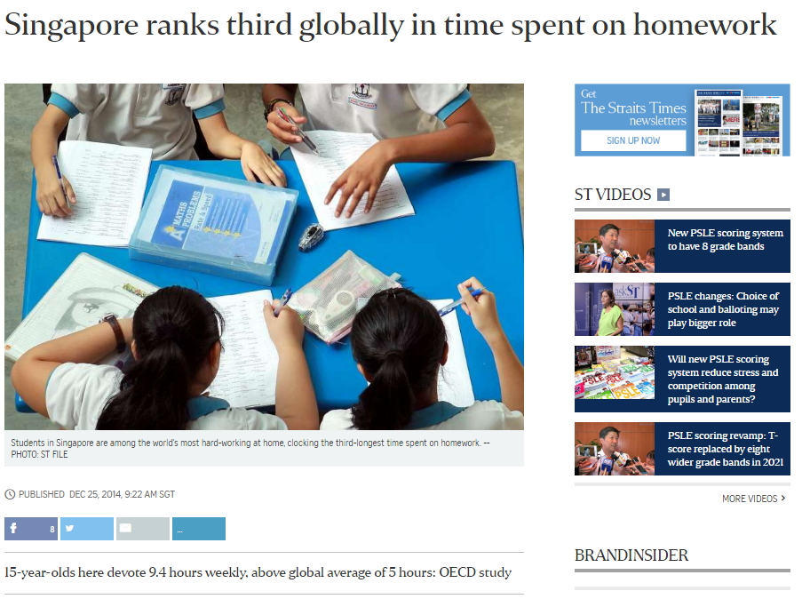
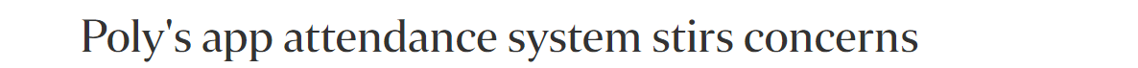
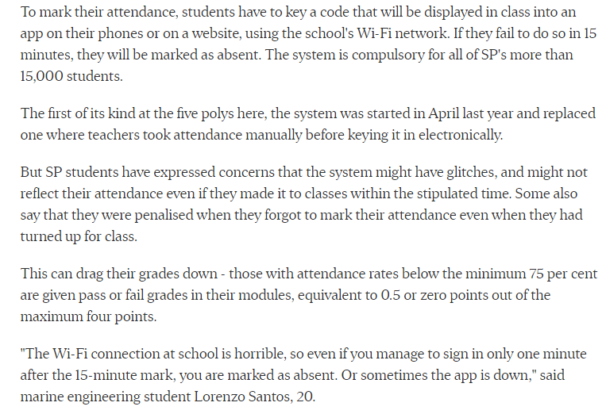

Slide 6
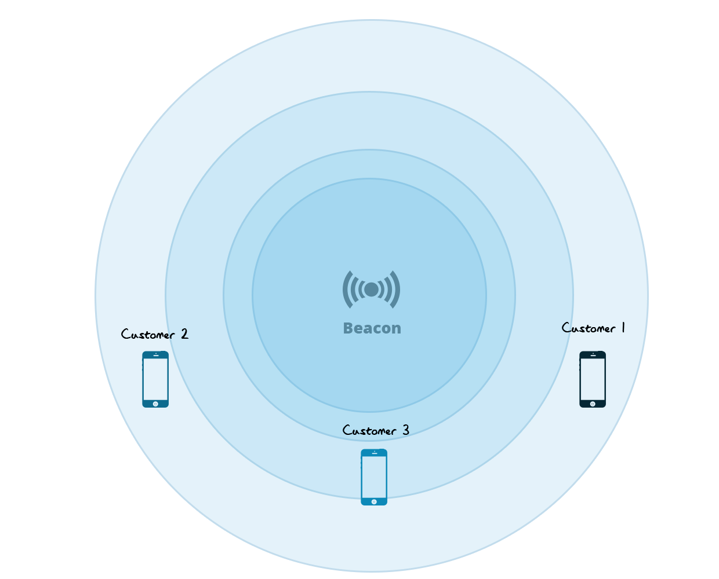
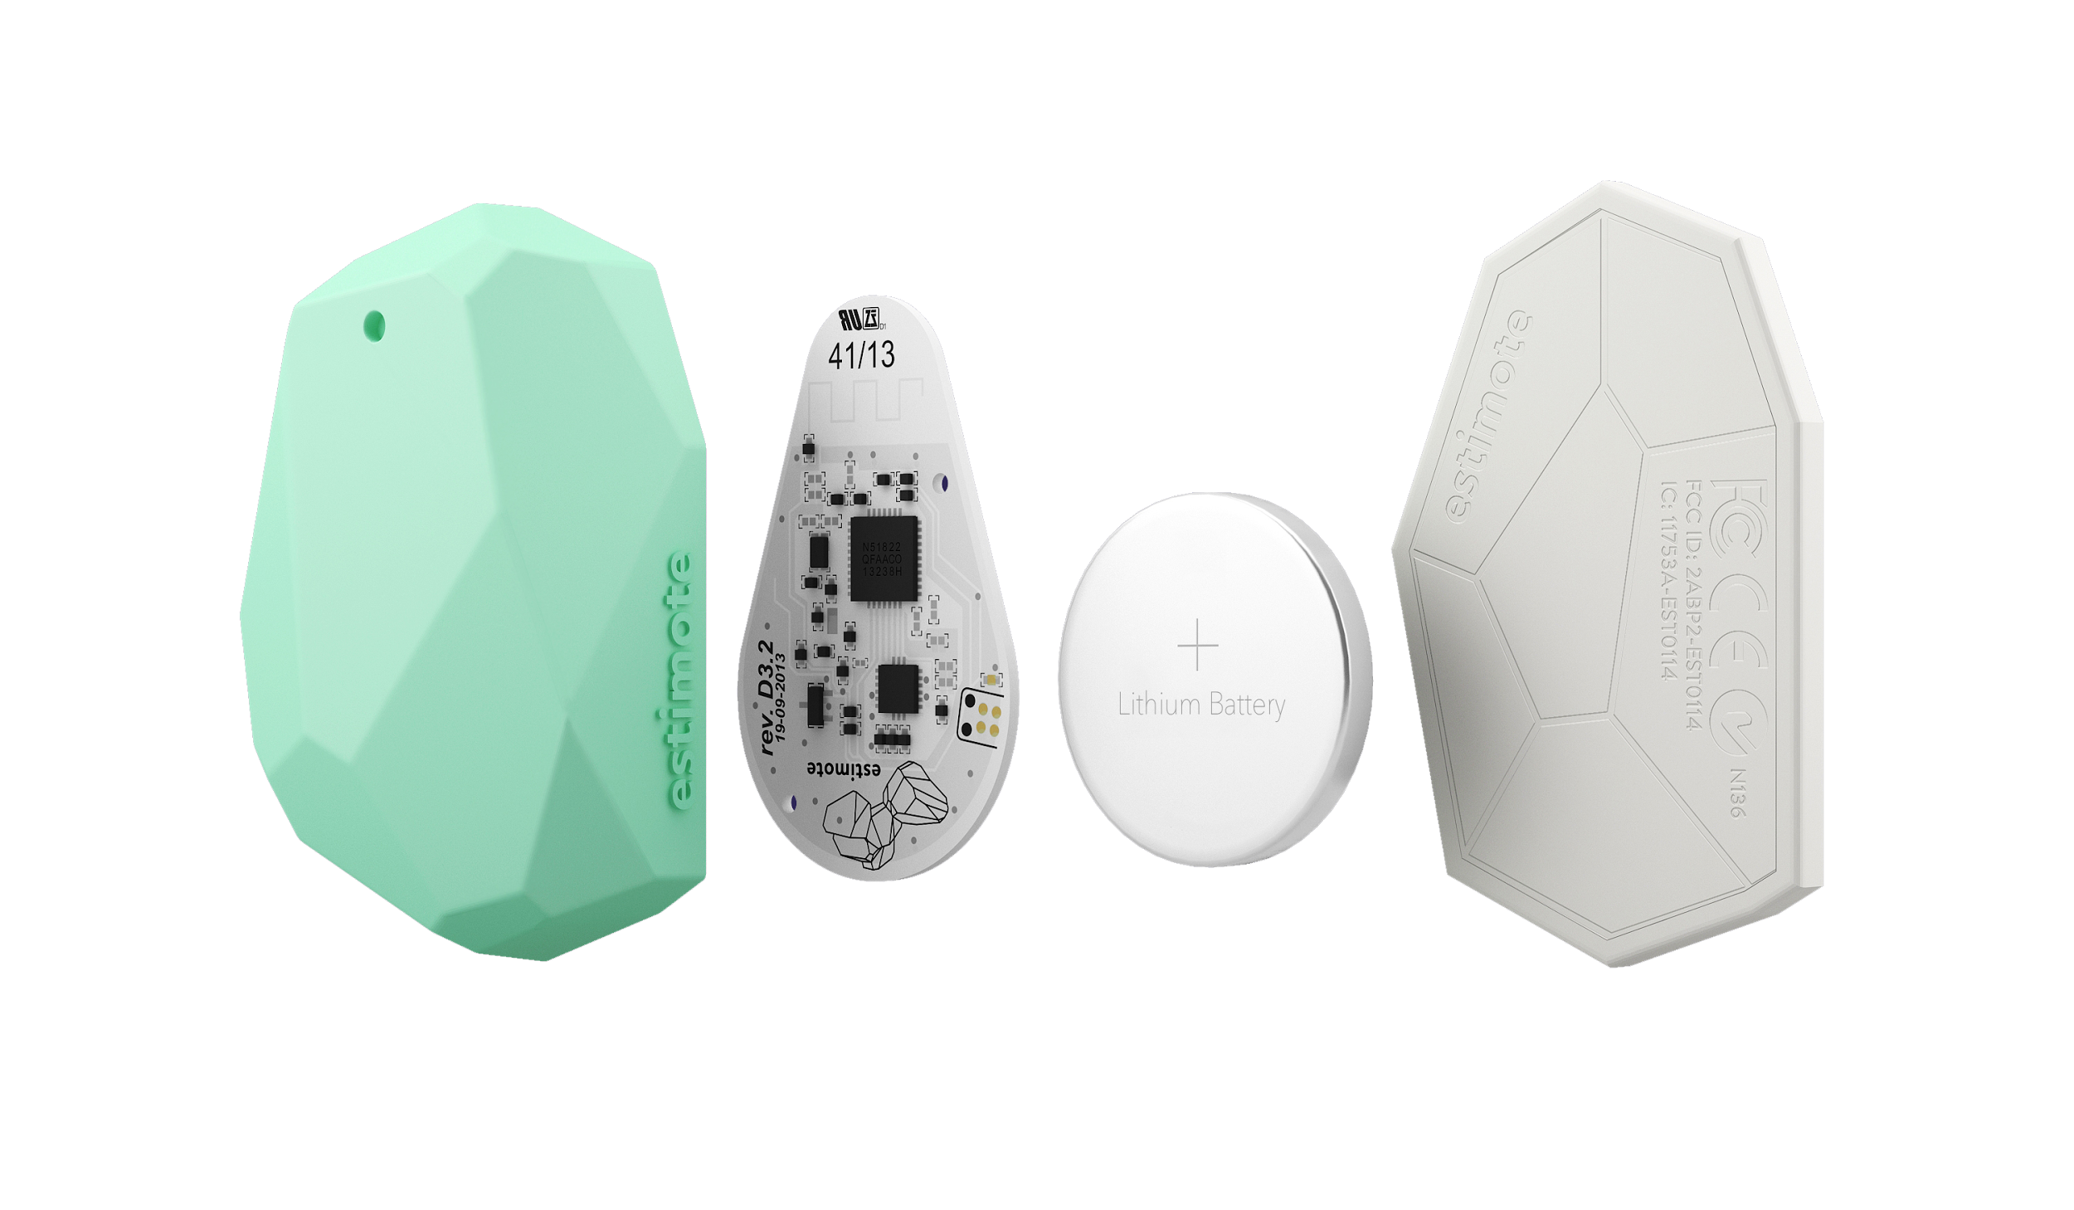
Attendance
Bluetooth beacons for attendance
Unique solution to maximise convenience

Slide 7
Attendance
Student
Ease of use: Just install, no additional setup
Teacher / Admin
Completely no manual effort needed
Extremely accurate & precise
Check attendance via web portal & Analytics

Slide 9
Homework / Task
Students
Crowdsourcing model within class
Accurate and low effort
Leaderboard/Incentivisation
Teachers
Monitor workload
Schedule tests

Slide 10
Location based info
Teachers
Ease in dissemination of info to relevant audience
Info at the right time & location
Students
Lesson info / materials, Next lesson info
Crowd density (canteen esp.)

Slide 11
Comprehensive
Considers all stakeholders' needs: students, teachers & admins

Slide 12
Integrated
Various modules are interdependent

Slide 13

Homework reminder
App knows where the student is in school
After user add their homework, the app will remind the user to hand in their homework during the relevant lesson

Slide 14
Reliable
Robust and scalable. Fuss-free experience for users.

Slide 15
Technologies Used
We use full stack technologies supported by tech giants like Google, Facebook & Apple to ensure a stable foundation for our system
Apple iBeacon & Bluetooth Low Energy 4.0
React Native Frontend
Cross-Platform
Google App Engine Backend
Scalable
Reliable

Slide 16
Testing/Development
App went through 3 stages of rigorous testing/usage
Initial beta:
~ 30 users
Alpha (added attendance feature):
~ 35 users
App is published:
~ 120 downloads on Google Play Store

Slide 17
Impactful
Making a difference in our school community

Slide 18
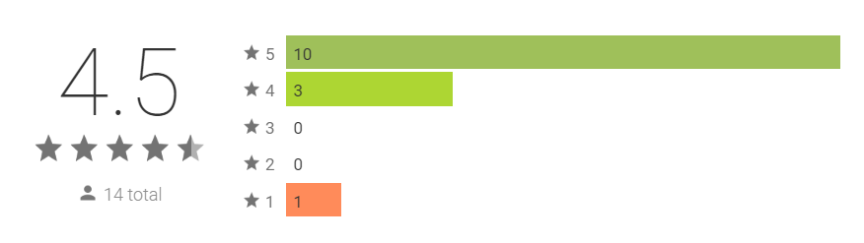
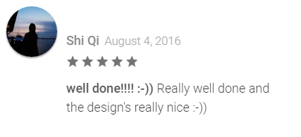
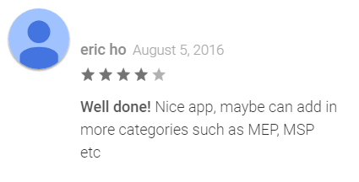
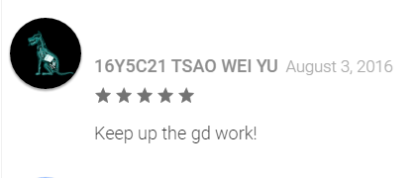
Usage/Reception

Slide 19
Usage
Homework/task management module released to whole school, has seen significant usage.
Students use eduto daily to manage their homework and tasks
Currently in discussion for school-wide rollout.

Slide 20
Endorsement
"A good, efficient communication tool.
Teaches students to be more responsible and independent in their learning."
Mdm Leong Foong Lin Senior High Year Head, Dunman High School

Slide 21
Endorsement
"It is a good collator of tasks to help students manage their load."
Mr Eugene Tan Head of Student Development, Dunman High School

Slide 22
Eduto is a comprehensive, integrated, reliable & extensible learning and administration system

